Slide 1
O&T Dashboard Weekly Project Management Status
Report Date: May 6, 2019

Slide 2
O&T Dashboard: Weekly Project Management Status
Key Ready to Serve (RTS) Activities
Accomplishments – Tableau
Enhancements None Operational Tasks Generated monthly PDF reports for Expense Reporting for the month of April 2019 - RITM1728619 - 5/2/19 Performed daily dashboard monitoring (data sources, extract refresh status) activities in the CorpSys for the month of April 2019 - RITM1685913 - 5/3/19 Provisioned user access for the following people: 6 users - GMO Post, Post-Client modules in theCenter and Global Media Operations folder in CorpSys - RITM1723396 - 4/30/19 Andrea Reliford - Training Management Dry Creek On Air folder in CorpSys - RITM1723756 - 4/30/19 Adrian Ritchie - Global Media Operations folder in CorpSys - RITM1727254 - 5/2/19 Peter Breuer - GMO Post and Post-Client modules in theCenter - RITM1727288 - 5/2/19 Revoked user access for the following people: 10 users - theCenter and the CorpSys production - RITM1722646 - 5/2/19 7 Tickets closed

Slide 3
O&T Dashboard: Weekly Project Management Status
Key Ready to Serve (RTS) Activities
Accomplishments – ETL
Enhancements (REL 20190503) Modified the Conference Room & Video Conference data load workflows to handle exception email notifications during the data rejections - ENHC0038188 - 5/3/19 1 Ticket closed Incidents Handled multiple STORM Attendance data load failures due to the Informatica connectivity issue - INC2351812, INC2352140, INC2356463, INC2356809 – from 4/27/19 through 5/3/19 Handled the Space Planning (East) data load failure due to the miss in scheduled delivery of the source files - INC2350510 - 4/29/19 Handled STORM Pacing dimension load failure that was caused by the network connectivity issue - INC2355790 - 5/2/19 6 Tickets closed Operational Tasks Performed the daily production support activities for the month of April 2019 - RITM1685980 - 4/30/19 Analyzed the data rejections in the Mosaic source file received for the Black Car Services module - RITM1720477 - 5/1/19 Coordinated with the EDM team on fixing NDI data mapping issues (Employee Type and Employee Status) in the EDNA system - RITM1615492 - 5/2/19 Analyzed the rejected record in the Posted Expense file received for the Travel & Expense module - RITM1728115 - 5/2/19 Manually processed the daily Space Planning (East) files missed on the delivery schedule - RITM1713356 - 5/3/19 5 Tickets closed

Slide 4
O&T Dashboard: Weekly Project Management Status
Key Program Activities
Accomplishments | Global Security Operations Metrics Birthright policy configuration has been setup for D3 Security in the Staging environment – 5/1/19 Received a detailed sample of JSON file format from D3 vendor for feasibility analysis 5/2/19 Established data relationships in the LRA/RRR tables and published Tableau data sources for building reports – 5/3/19 Report Request Form Reviewed the current request form for necessary changes required – 4/30/19 Initiated the development on building a new report request form in SharePoint – 5/2/19 Tableau Shared Environment Created a summary for weighing options on the CorpSys migration to the shared environment – 4/29/19
Upcoming Activities | Global Security Operations Metrics Perform UAT on the Birthright configuration setup for the D3 Security application in the Staging environment – 5/10/19 Provide necessary UAT support for testing LRA and RRR reports – 5/10/2019 Perform analysis on the sample JSON file received from the D3 vendor for viable Teradata integration – 5/10/19 Report Request Form Develop the new report request form using MS Forms and required business workflow in SharePoint – 5/10/19 Perform system testing on the new dashboard report request form – 5/17/19 TLMD Spector360 Transition application and processes to TLMD team - TBD Tableau Shared Environment Review the pros & cons and make a decision on CorpSys migration to the shared environment – 5/10/19

Slide 5
O&T Dashboard: Weekly Project Management Status
Key Ready to Serve (RTS) Activities - In Progress Items - Tableau
Ticket Headline | Module | Priority | Ticket Number | Type | Assigned To | Current Phase | Current Owner | Next Step | Request Date | Prod Date | Duration (Business Days) | Estimated Hours | Production Delayed Reason | Status | % Complete
Create Tableau data sources using LRA and RRR database tables | Global Security | P2 | ENHC0037605 | ENH | Palguna | Analysis | Palguna | Development | 3/14 | 5/10 | 37 |  |  |  | 70%
Develop new Ops Readiness and Absorb Dashboards | GMO | P2 | ENHC0038217 | ENH | Karthick | Development | Karthick | Unit Testing | 4/25 | 5/10 | 7 |  |  |  | 40%
Correct the user count mismatch between the OTS Admin Report and the License Report | All Modules | P4 | RITM1403594 | SR | Karthick | Validation | Karthick | Close | 8/24 | 5/15 | 181 |  |  |  | 80%
STORM reports phase-3 enhancements | RCO | P2 | ENHC0038027 | ENH | Palguna | Development | Palguna | Unit Testing | 4/15 | 5/17 | 15 |  |  |  | 2%
Build a new GMO Post Capacity Dashboard | GMO | P3 | ENHC0037876 | ENH | Palguna | UAT | Simone | Deployment | 4/4 | 5/18 | 22 |  |  |  | 70%
Integrate Storm Gantt Chart into Storm Facility Report | RCO | P3 | ENHC0037792 | ENH | Palguna | Development | Palguna | Unit Testing | 3/28 | 5/20 | 27 |  |  |  | 30%
Enable Cozi and Telexitos networks in Entertainment for GMO Ops Slide. Rename NOC header by EC NOC in Joes' Ops Slide | GMO | P4 | ENHC0037980 | ENH | Palguna | Pending Response | GMO Team | Development | 4/11 | 5/24 | 17 |  |  |  | 50%
Automate the monthly OTS Reliability report for Mark Hunt | GMO | P4 | RITM1690389 | SR | Palguna | Analysis | Karthick | Development | 4/3 | 5/24 | 23 |  |  |  | 10%
Add SAP hierarchy filter to STORM News Tour Report | RCO | P4 | ENHC0037861 | ENH | Palguna | Analysis | Palguna | Development | 4/3 | 5/24 | 23 |  |  |  | 2%
Include Fiscal Calendar information in the STORM News reports | RCO | P4 | ENHC0036777 | ENH | Palguna | Development | Palguna | Unit Testing | 1/16 | 5/28 | 78 |  |  |  | 5%

Slide 6
O&T Dashboard: Weekly Project Management Status
Key Ready to Serve (RTS) Activities - In Progress Items - Tableau
Ticket Headline | Module | Priority | Ticket Number | Type | Assigned To | Current Phase | Current Owner | Next Step | Request Date | Prod Date | Duration (Business Days) | Estimated Hours | Production Delayed Reason | Status | % Complete
Provide the Daisy meta data and a sample data to Tynelle | Support | P4 | RITM1679176 | SR | Palguna | Development | Palguna | Review & Feedback | 3/26 | 5/30 | 29 |  |  |  | 50%
Medea data integration into Teradata and Tableau | GMO | P4 | RITM1477154 | SR | Karthick | Pending Mockup | Raj | Analysis | 10/16 | 5/30 | 144 |  |  |  | 10%
Automation of GMO Premiere Slide dashboard | GMO | P4 | ENHC0036562 | ENH | Palguna | UAT | Neha | Deployment | 12/20 | 5/31 | 97 |  |  |  | 85%
Enhancements to dashboard filters in the Conference Rooms report | RCO | P3 | ENHC0037411 | ENH | Palguna | Review & Feedback | Carl | Unit Testing | 2/27 | 5/31 | 48 |  |  |  | 65%
Increase reliability score precision to 5 decimals points in the Monthly Reliability dashboard | GMO | P4 | ENHC0036768 | ENH | Karthick | Pending Review | GMO Team | Deployment | 1/15 | 5/31 | 79 |  |  |  | 10%
Build EMCOR reports using data sets and report mockups from Larry | RCO | P4 | ENHC0035880 | ENH | Palguna | Pending Mockup | Palguna | Analysis | 10/19 | 5/31 | 141 |  |  |  | 5%
Analyze the false M360 alerts generated for O&T Dashboard | All Modules | P4 | RITM1516757 | SR | Palguna | Analysis | Palguna | Review & Feedback | 11/15 | 6/4 | 122 |  |  |  | 75%
Automation of manual adjustments in Space Planning for Aging Vacancy Trend report | RCO | P4 | ENHC0033408 | ENH | Palguna | Pending Approval | Palguna | Development | 5/21 | 6/15 | 250 |  |  |  | 5%
Integration of Lyft data in the Car Services HQ Report | Expense Reporting | P4 | ENHC0034573 | ENH | Palguna | On Hold | Palguna | Deployment | 7/19 | 6/30 | 207 |  |  |  | 85%
Integration of Lyft data in the Consolidated HQ Report | Expense Reporting | P4 | ENHC0034680 | ENH | Palguna | On Hold | Palguna | Deployment | 7/25 | 6/30 | 203 |  |  |  | 85%

Slide 7
O&T Dashboard: Weekly Project Management Status
Key Ready to Serve (RTS) Activities - In Progress Items - ETL
Ticket Headline | Module | Priority | Ticket Number | Type | Assigned To | Current Phase | Current Owner | Next Step | Request Date | Prod Date | Duration (Business Days) | Estimated Hours | Production Delayed Reason | Status | % Complete
Coordinate on access to the CenterStone data in Teradata for the ACOE team | RCO | P3 | RITM1723162 | SR | Paul Naveen | In progress | Paul Naveen | Complete | 5/3 | 5/6 | 6 |  |  |  | 85%
Black Car data load failed due to incorrect Alpine source file format | Expense Reporting | P3 | INC2356672 | INC | Paul Naveen | In progress | Aswin | Complete | 5/3 | 5/7 | 3 |  |  |  | 50%
Process the STORM Fiscal Date mapping file in Stage | RCO | P3 | RITM1703319 | SR | Paul Naveen | In progress | Aswin | Complete | 4/12 | 5/8 | 19 |  |  |  | 70%
Analyze on duplicate bookings in the Conference Rooms dashboard | RCO | P3 | RITM1673228 | SR | Paul Naveen | In progress | Aswin | Complete | 3/21 | 5/9 | 36 |  |  |  | 80%
Load Jan-Apr 2019 Badge Swipe data in Teradata Stage | Global Security | P3 | RITM1727945 | SR | Paul Naveen | In progress | Paul Naveen | Complete | 5/2 | 5/9 | 6 |  |  |  | 75%
Correct the user count mismatch between OTS Admin and License reports | Data Security | P2 | RITM1681826 | SR | Paul Naveen | In progress | Aswin | Complete | 3/28 | 5/10 | 32 |  |  |  | 80%
Take over the Daily Outage map SOP from GMO team | GMO | P3 | RITM1723188 | SR | Paul Naveen | In progress | Paul Naveen | Complete | 3/29 | 5/10 | 31 |  |  |  | 75%
Add new field to the STORM Facility report | RCO | P3 | ENHC0037983 | ENH | Paul Naveen | Integration Testing | Paul Naveen | UAT | 4/12 | 5/16 | 25 |  |  |  | 60%
Analyze to pull data for Keith Jackson and Joe Crescitelli organizations | GMO | P3 | RITM1726694 | SR | Paul Naveen | In progress | Paul Naveen | Complete | 5/1 | 5/17 | 13 |  |  |  | 15%
Build a new GMO Post Capacity dashboard | GMO | P2 | ENHC0037876 | ENH | Paul Naveen | Scoping | Paul Naveen | Development | 4/4 | 5/17 | 32 |  |  |  | 5%
Coordinate on the Informatica connectivity issue for the STORM Attendance Tracker report | RCO | P1 | RITM1653353 | SR | Paul Naveen | In progress | Informatica Admin Team | Complete | 3/8 | 5/21 | 53 |  |  |  | 60%

Slide 8
O&T Dashboard: Weekly Project Management Status
Key Ready to Serve (RTS) Activities - In Progress Items - ETL
Ticket Headline | Module | Priority | Ticket Number | Type | Assigned To | Current Phase | Current Owner | Next Step | Request Date | Prod Date | Duration (Business Days) | Estimated Hours | Production Delayed Reason | Status | % Complete
Perform sanity testing on the Informatica upgrade to v10.2 | All Modules | P3 | RITM1715539 | SR | Paul Naveen | In progress | Raj B | Complete | 4/23 | 5/21 | 21 |  |  |  | 1%
Build Absorb hierarchy data for Ops dashboard | GMO | P2 | ENHC0037824 | ENH | Paul Naveen | Integration Testing | Raj B | UAT | 4/1 | 5/23 | 39 |  |  |  | 75%
Explore the options to save Absorb source files in the Unix server | GMO | P3 | RITM1724292 | SR | Paul Naveen | In progress | Raj B | Complete | 3/30 | 5/24 | 40 |  |  |  | 15%
Perform daily production support activities for May 2019 | Support | P3 | RITM1685980 | SR | Paul Naveen | In Progress | Paul Naveen | Complete | 5/1 | 5/31 | 23 |  |  |  | 10%
StudioPost - ScheduALL data integration into Teradata | GMO | P2 | ENHC0036020 | ENH | Paul Naveen | Integration testing | Raj B | UAT | 10/31 | 6/10 | 159 |  |  |  | 75%
WorldApp (LRA / RRR) data integration to Teradata | Global Security | P2 | ENHC0037615 | ENH | Paul Naveen | Development | Aswin | Integration Testing | 1/9 | 6/14 | 113 |  |  |  | 75%
Analysis on automating the Finance Allocations data process | GMO | P3 | RITM1718184 | SR | Paul Naveen | Requirement Gathering | Paul Naveen | Analysis | 4/24 | TBD | 8 |  |  |  | 5%
Veriato data integration to Teradata | Expense Reporting | P2 | ENHC0036690 | ENH | Paul Naveen | Integration testing | Raj B | UAT | 1/9 | TBD | 83 |  |  |  | 85%
Coordinate on Media Broker data integration with NDI using Teradata | GMO | P3 | RITM1682462 | SR | Paul Naveen | In progress | Paul Naveen | Complete | 3/29 | TBD | 26 |  |  |  | 15%
Develop a ServiceNow dashboard for daily status & effort tracking | All Modules | P4 | RITM1517523 | SR | Paul Naveen | In progress | Paul Naveen | Complete | 11/15 | TBD | 122 |  |  |  | 35%
Collect Archibus Data Warehouse requirements | RCO | P3 | RITM1620325 | SR | Paul Naveen | Requirement Gathering | Paul Naveen | Estimation | 2/11 | TBD | 60 |  |  |  | 35%
Data integration from the D3 system into Teradata | Global Security | P3 | RITM1558793 | SR | Paul Naveen | Requirement Gathering | Paul Naveen | Analysis | 12/20 | TBD | 97 |  |  |  | 30%

Slide 9
O&T Dashboard: Weekly Project Management Status
Tableau ServiceNow Tickets ~ As of 5/3/2019
Module/Function | Application Requests (Defects / Enhancements) |  |  |  |  | Service Requests |  |  |  | Incident | Release | Change Request | Change Task | Total
 | Scoping | On Hold | Work In Progress | Completed | Deployment | Submitted | In Progress | On Hold | Completed
All Modules | 2 |  | 1 |  |  | 1 |  |  | 1 |  |  |  | 1 | 6
Expense Reporting |  | 1 |  |  |  |  | 1 | 1 | 1 |  |  |  |  | 4
GMO | 1 | 4 |  |  |  |  | 2 |  | 1 |  | 1 |  |  | 9
RCO |  |  |  |  |  |  | 2 |  | 1 |  |  | 1 | 1 | 5
Support |  | 4 |  |  |  |  | 1 |  |  |  |  |  |  | 5
PDF Reports | 1 |  | 1 |  |  |  | 1 | 2 |  |  |  |  |  | 5
User Access |  | 1 | 1 |  |  |  | 2 |  | 3 |  |  |  |  | 7
Grand Total | 4 | 10 | 3 | - | - | 1 | 9 | 3 | 7 | - | 1 | 1 | 2 | 41

Slide 10
O&T Dashboard: Weekly Project Management Status
ETL ServiceNow Tickets ~ As of 5/3/2019
Module/Function | Application Requests (Defects / Enhancements) |  |  |  |  | Service Requests |  |  |  | Incident | Release | Change Request | Change Task | Total
 | Scoping | On Hold | Work In Progress | Completed | Deployment | Submitted | In Progress | On Hold | Completed
All Modules |  |  |  |  |  |  | 4 |  |  |  |  |  |  | 4
Expense Reporting |  | 1 | 1 |  |  |  |  |  | 2 | 1 |  |  | 3 | 8
GMO |  |  | 3 |  |  | 2 | 5 | 1 |  |  |  | 1 |  | 12
RCO | 1 | 1 | 1 | 1 |  | 1 | 4 | 1 | 1 | 6 | 1 | 1 | 2 | 21
Support |  |  |  |  |  | 2 | 1 | 1 | 2 |  |  |  |  | 6
Data Security |  |  |  |  |  |  | 1 |  |  |  |  |  |  | 1
Global Security |  |  | 1 |  |  |  | 1 |  |  |  |  |  |  | 2
Grand Total | 1 | 2 | 6 | 1 | - | 5 | 16 | 3 | 5 | 7 | 1 | 2 | 5 | 54

Slide 11
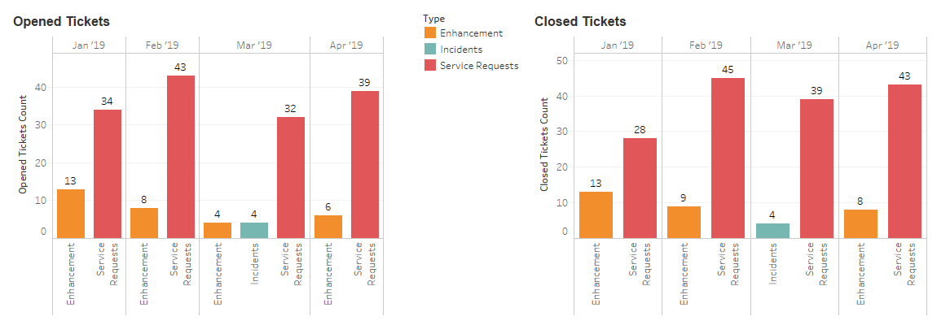
O&T Dashboard: Weekly Project Management Status
Ticket Category – Monthly Breakdown (Tableau)
2019 | Enhancements |  |  | Service Requests |  |  | Incidents |  |  | Defects |  |  | TOTAL
 | Open | Closed | Balance | Open | Closed | Balance | Open | Closed | Balance | Open | Closed | Balance | Open | Closed | Balance
Jan | 13 | 13 | 16 | 34 | 28 | 32 | 0 | 0 | 0 | 0 | 0 | 0 | 47 | 41 | 48
Feb | 8 | 9 | 15 | 43 | 45 | 30 | 0 | 0 | 0 | 0 | 0 | 0 | 51 | 54 | 45
Mar | 4 | 0 | 19 | 32 | 39 | 23 | 4 | 4 | 0 | 0 | 0 | 0 | 40 | 43 | 42
Apr | 6 | 8 | 17 | 39 | 43 | 19 | 0 | 0 | 0 | 0 | 0 | 0 | 45 | 51 | 36
May
Jun
Jul
Aug
Sep
Oct
Nov
Dec
TOTAL | 31 | 30 | 15 | 148 | 155 | 30 | 4 | 4 | 0 | 0 | 0 | 0 | 183 | 189 | 36

Slide 12
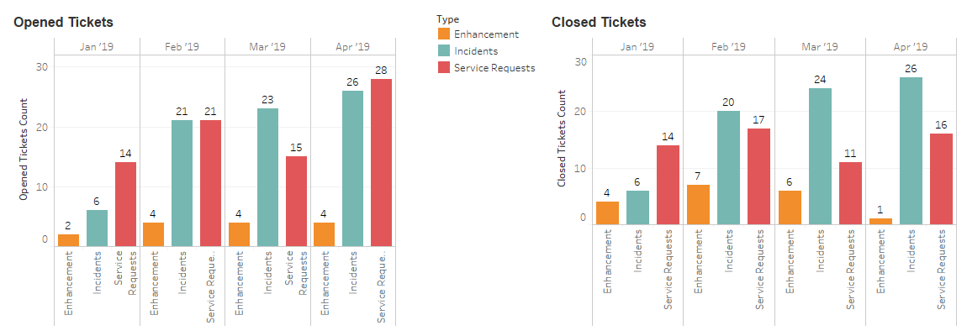
O&T Dashboard: Weekly Project Management Status
Ticket Category – Monthly Breakdown (ETL)
2019 | Enhancements |  |  | Service Requests |  |  | Incidents |  |  | Defects |  |  | TOTAL
 | Open | Closed | Balance | Open | Closed | Balance | Open | Closed | Balance | Open | Closed | Balance | Open | Closed | Balance
Jan | 2 | 4 | 11 | 14 | 14 | 8 | 6 | 6 | 0 | 0 | 0 | 0 | 22 | 24 | 19
Feb | 4 | 7 | 8 | 21 | 17 | 12 | 21 | 20 | 1 | 0 | 0 | 0 | 46 | 44 | 21
Mar | 4 | 6 | 6 | 15 | 11 | 16 | 23 | 24 | 0 | 0 | 0 | 0 | 42 | 41 | 22
Apr | 4 | 1 | 9 | 25 | 21 | 20 | 26 | 26 | 0 | 0 | 0 | 0 | 55 | 48 | 29
May
Jun
Jul
Aug
Sep
Oct
Nov
Dec
TOTAL | 14 | 18 | 9 | 75 | 63 | 20 | 76 | 76 | 0 | 0 | 0 | 0 | 165 | 157 | 29

Slide 13
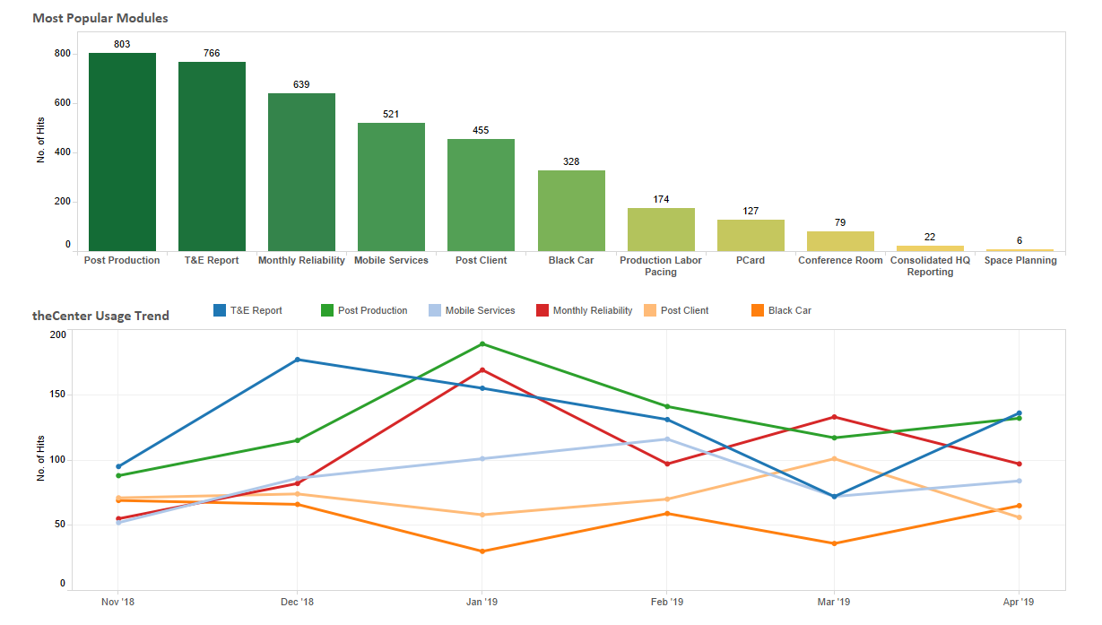


13
O&T Dashboard: Weekly Project Management Status
theCenter Utilization Stats for the last 6 months

Slide 14
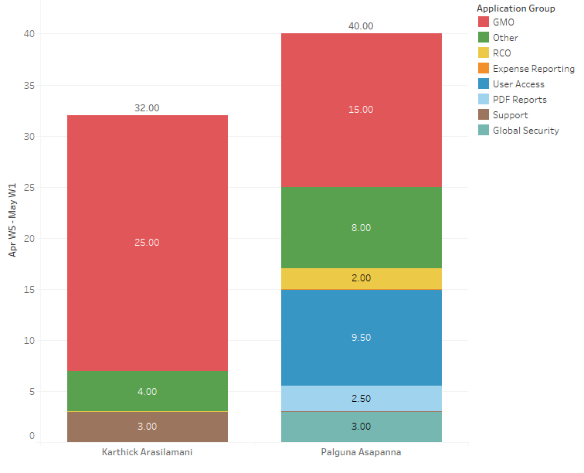
O&T Dashboard: Weekly Project Management Status
Overall Resource Utilization ~ Week Ending 5/3/2019 - Tableau
*All Modules refers to User Provisioning requests, ETL monitoring tasks, system testing and any O&T related requests with other teams.

Slide 15
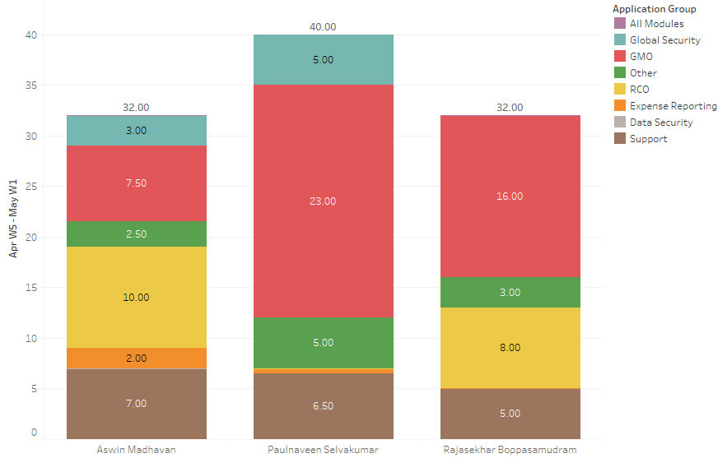
O&T Dashboard: Weekly Project Management Status
Overall Resource Utilization ~ Week Ending 5/3/2019 - ETL
*All Modules refers to User Provisioning requests, ETL monitoring tasks, system testing and any O&T related requests with other teams.

Slide 16
O&T Dashboard: Weekly Project Management Status
Resource Breakdown Hours (Tableau, ETL & .NET) – Period Ending 5/3/2019
Tableau
Resources | Roles | Location | Planned Hours | Actual Hours |  |  | Variance Hours Planned vs. Actual
 |  |  |  | O&T Dashboard | Other | Total
Palguna Asapanna | Tableau Sr. Developer | Onsite | 40.00 | 32.00 | 8.00 | 40.00 | 0.00
Karthick Arasilamani | Tableau Sr. Developer | Offshore | 40.00 | 28.00 | 4.00 | 32.00 | 8.00
Grand Total |  |  | 80.00 | 60.00 | 12.00 | 72.00 | 8.00
ETL
Resources | Roles | Location | Planned Hours | Actual Hours |  |  | Variance Hours Planned vs. Actual
 |  |  |  | O&T Dashboard | Other | Total
Paulnaveen Selvakumar | ETL Development & Support | Onsite | 40.00 | 35.00 | 5.00 | 40.00 | 0.00
Rajasekhar Boppasamudram | ETL Development | Offshore | 40.00 | 29.00 | 3.00 | 32.00 | 8.00
Aswin Madhavan | ETL Support | Offshore | 40.00 | 29.50 | 2.50 | 32.00 | 8.00
Grand Total |  |  | 120.00 | 93.50 | 10.50 | 104.00 | 16.00
.NET
Resources | Roles | Location | Planned Hours | Actual Hours |  |  | Variance Hours Planned vs. Actual
 |  |  |  | O&T Dashboard | Other | Total
NithyaKumar Rangan | .NET Support | Onsite | 3.00 | 0.00 | 0.00 | 0.00 | 3.00
Grand Total |  |  | 3.00 | 0.00 | 0.00 | 0.00 | 3.00

Slide 17
O&T Dashboard: Weekly Project Management Status
Thank You

